Slide 1
Increased Risk of Complications Following Nd:YAG Capsulotomy for PCO in Diabetic Versus Nondiabetic Patients
Adam G. Chun, MD
Jennifer H. Hung, MD
University of South Carolina, School of Medicine
Department of Ophthalmology
The authors have no financial interest in the subject matter of this e-poster.

Slide 2
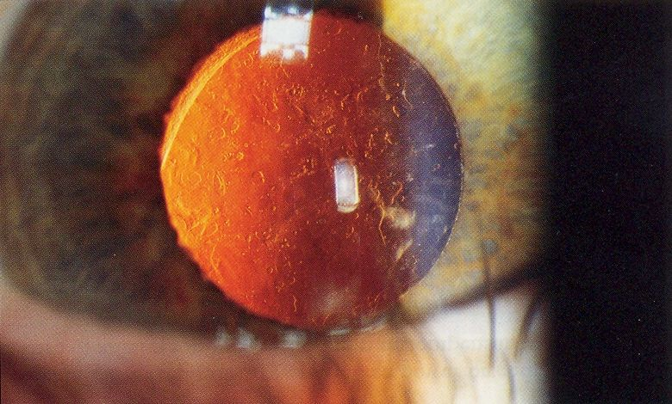
Purpose
To evaluate the incidence of complications after Nd:YAG capsulotomy for posterior capsule opacification in the diabetic vs. non-diabetic population performed by resident surgeons.

Slide 3
Background
Posterior capsular opacification (PCO) is the most common complication following cataract surgery¹
Only effective means of treating PCO is with Nd:YAG laser capsulotomy
Prior studies have shown varying rates of PCO development in diabetic compared with controls^{2,3,6}
Typical complications: RD, CME, damage to IOL, corneal edema, elevated IOP, seeding of endophthalmitis⁴

Slide 4
Methods
Retrospective study of 50 eyes of 44 patients undergoing Nd:YAG capsulotomy
All cases performed by resident surgeons at a single surgical site
Complete dilated preoperative and postoperative exams done at 3-4 weeks, 3 months and 6 month follow-up
Monitoring for retinal detachment, cystoid macular edema and other complications noted

Slide 5
Results
18 diabetic eyes and 32 non-diabetic eyes underwent Nd:YAG capsulotomy
Diabetic Complications
2 CME
2 Macular holes
1 retinal detachment
Non-diabetic complications: None

Slide 6
Results
Rates of complications of diabetics
11% developed CME
11% developed macular holes
5% developed retinal detachments
Overall complications for all patients at single surgical site by Resident surgeons
4% CME
4% Macular hole
2% retinal detachments

Slide 7
Results

Slide 8
Limitations
Small sample size
Short duration of follow-up
Total Nd:YAG laser power used not taken into account
Axial length and refractive error was not taken into account
Intraoperative complications not examined

Slide 9
Conclusions
Complication following Nd:YAG capsulotomy were only seen in the diabetic group
Macular holes were seen in 2 cases with no associated RD
Incidence of CME and retinal detachments at this surgical site by resident surgeons are comparable to that found in the literature^{8,9,10}
Diabetics should be counseled as to increased risk of complications following laser capsulotomy

Slide 10
References
Wilson ME Jr, Trivedi RH. The ongoing battle against posterior capsular opacification. Arch Ophthalmol. 2007; 125(4) 555-556
Nekolova J, Pozlerova J, Jiraskova N, Rozsival P. Posterior capsule opacification in patients with type 2 diabetes mellitus. Cesk Slov Oftalmol. 2008 Sep;64(5):193-6
Awasthi N, Guo S, Wagne B. Posterior Capsular Opacification. Arch Ophthalmol. 2009; 127(4): 555-562
Elgohar MA, Dowler JG. Incidence and risk factors of ND: YAG capsulotomy after phacoemulsification in non-diabetic and diabetic patients. Clin Experiment Ophthalmol. 2006 Aug: 34(6): 526-534
Karczewicz D, Lubinski W, Podboraczynska-JodkoK, Spoz E. Pseudophakic retinal detachment after cataract surgery by phacoemulsification. Ann Acad Med Stetin. 2006; 52(2): 79-82
Hayashi K, Hayashi H, Nakao F, Hayashi F. Posterior capsule opacification after cataract surgery in patients with diabetes mellitus. Am J opthalmol. 2002 Jul; 134(1):10-16
Auffarth GU, Nimsgern C, Tetz MR, Volcker HE. Analysis of energy levels for Nd:YAG laser capsulotomy in secondary catract. Ophthalmologe. 2000 Jan: 97(1): 1-4
Sakimoto S, SaitoY. Acute macular hole and retinal detachment in highly myopic eyes after neodymium:YAG laser capsulotomy. J Cataract Refract Surg. 2008 Sep; 34(9):1592-4
Burq MA, Taqui AM. Frequency of retinal detachment and other complications after neodymium: YAG laser capsulotomy. J Pak Med Assoc. 2008; 58(10): 550-2
Ranta P, Tommila P, Kivela T. Retinal breaks and detachment after neodymium: YAG laser posterior capsulotomy: five-year incidence in a prospective cohort. J Cataract Refract Surg. 2004 Jan; 30(1): 58-66

