Slide 1
Earliest Reported Case of Terson Syndrome
Brad Ballard MD
Suzie Nemmers MD
Lynnette Johnson MD
Taylor Sawyer MD
The authors received funding from the Department of Defense (DoD) to attend this conference.
The authors views are personal and do not reflect official policy of the DoD, the US Army of any of its affiliates.

Slide 2
Purpose
To describe the earliest known diagnosis of Terson syndrome in a 3 day old full term neonate.

Slide 3
Case
1650 g male via C/S at 37 weeks EGA
Non-reassuring fetal heart tracing
Required positive pressure ventilation, CPR x 90 seconds, and intubation
MRI on DOL 3 showed right MCA infarction with hemorrhagic transformation and subarachnoid hemorrhage
DFE showed multilayer retinal hemorrhages

Slide 4
Case
Regular dilated exams showed clearance of retinal hemorrhage and serial ultrasounds showed no worsening of intracranial path.
Thrombophilia workup showed decreased ATIII, Protein C/S likely from consumption coagulopathy from ICH.

Slide 5
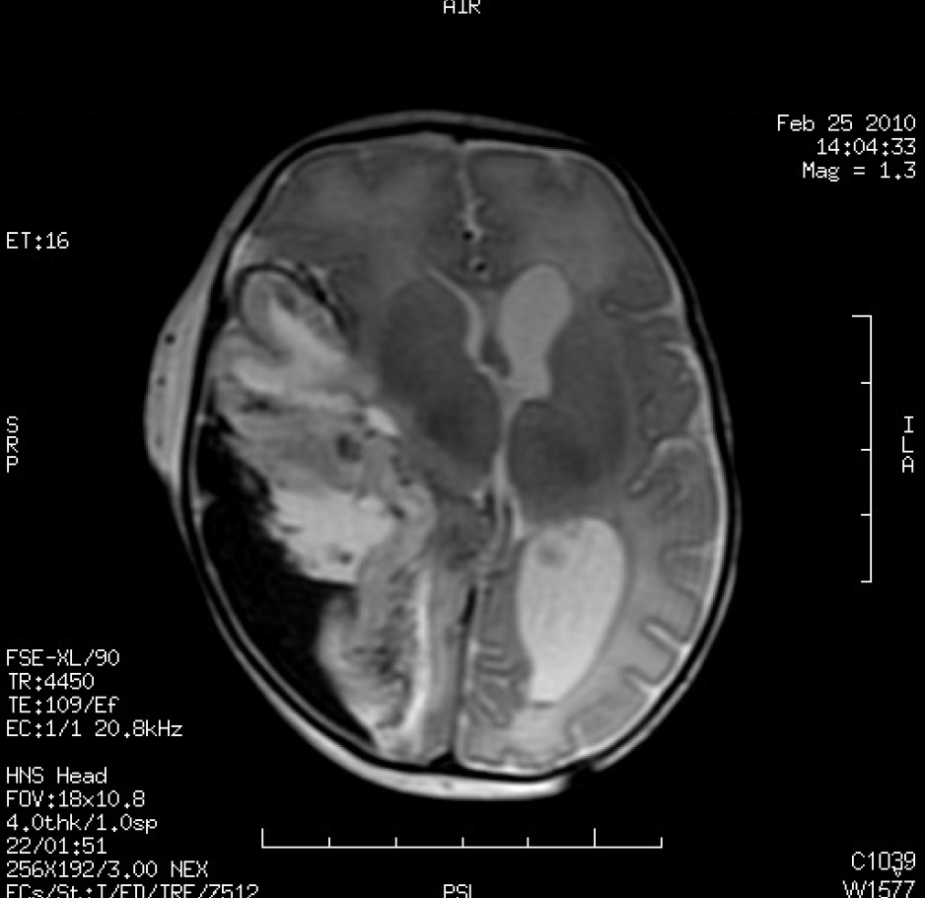
T2 weighted magnetic resonance imaging of the brain at two days of life showing right middle cerebral artery infarction with post-hemorrhagic intraparenchymal hematoma and moderate ventriculomegaly.

Slide 6
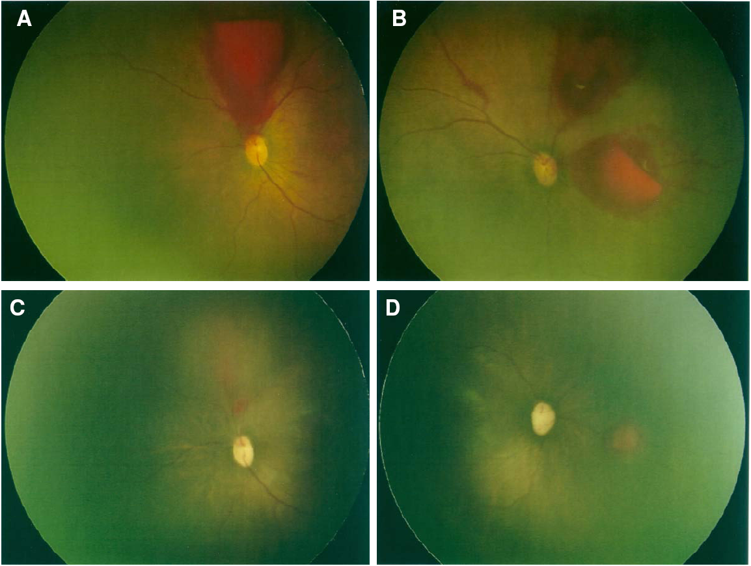
RetCam™ image of the retina. A & B. left eye and right eye respectively at 3 days of life showing multi-layer retinal hemorrhages. C & D. left and right eye respectively at 35 days of life showing near complete resolution of retinal hemorrhages.

Slide 7
DDx
Birth Trauma
  However, baby born via cesarean
CPR
  Brief duration – 90 seconds
Coagulopathies
  NICU team felt consumptive process from ICH caused ATIII, protein C and S deficiencies
Thrombocytopenia

Slide 8
DDx
Vasculopathies
  Not likely in this case
NAT
  Not likely in this case
Intracranial Hemorrhages/Terson Syndrome
  Increased ICP transmitted down nerve sheath causing retinal hemorrhages from blood vessel rupture in multiple retinal layers.

Slide 9
Conclusion
In adults, Terson syndrome is a marker of poor prognosis for intracranial hemorrhages.
Unknown about it prognostic implications in neonates
May cause amblyopia, poliferative retinal detachments, epiretinal membranes, and may require vitrectomy.

Slide 10
Conclusion
One meta-analysis showed 13% of patients with intracranial hemorrhage showed intraocular hemorrhage as well.
Most intracranial hemorrhages have no fundoscopic exam.
But, does knowing that Terson syndrome is present change management?
  No visual change
  Higher risk of death 10 vs 50%

Slide 11
Conclusion
We report the earliest known case of Terson syndrome resulting from a large MCA infarction. Based on our case, and other cases of neonatal Terson syndrome associated with MCA infarction, ophthalmologic exam should be considered in all infants with significant MCA infarction to evaluate for Terson syndrome.

